Slide 1
Context-Free Grammars
Mohammad Hasan
CSE, CUET

Slide 2
“Too many Computers,
In too many Countries
Recognize the same Language,
The language of CFG”

Slide 3
Context-Free Languages
Context-Free
Grammars
Pushdown
Automata
stack
automaton

Slide 4
Introduction
CFG have played a central role in compiler technology since the 1960’s.
They turned the implementation of parsers
Parsers functions: discover the structure of a program.
Other Uses: document-type definition (DTD), XML (extensible markup language)

Slide 5
CFG: Informal Example
Palindromes
A palindrome is a string that reads the same forward & backward, such as otto, madamimadam (“Madam, I m Adam”,).
Let’s consider describing only the palindromes with alphabet {0,1}.

Slide 6
palindrome : 0110,11011
Not palindrome: 011, 0101
Properties: it must begin & end with the same symbol. When the 1st & last symbols are removed, the resulting string must also be a palindrome
Basis: ε, 0 and 1 are palindromes

Slide 7
Induction: if w is a palindromes, so are 0w0 & 1w1. No string is a palindrome of 0’s & 1’s, unless it follows from this basis & induction rule
CFG for Palindromes
P →є
P →0
P →1
P →0P0
P →1P1
Only for binary strings.
Basis
Induction

Slide 8
Informal Comments
A context-free grammar is a notation for describing languages.
It is more powerful than FA/RE’s, but still cannot define all possible languages.
Useful for nested structures, e.g., parentheses in programming languages.

Slide 9
Informal Comments – (2)
Basic idea is to use “variables” to stand for sets of strings (i.e., languages).
These variables are defined recursively, in terms of one another.
Recursive rules (“productions”) involve only concatenation.
Alternative rules for a variable allow union.

Slide 10
Example: CFG for { 0^{n}1^{n} | n > 1}
Productions:
  S -> 01
  S -> 0S1
Basis: 01 is in the language.
Induction: if w is in the language, then so is 0w1.

Slide 11
Definition of CFG
Terminals: There is a finite set of symbols that form the strings of the language being defined.
Non-terminals: There is a finite set of variables. Each variable represents a language (a set of strings).
Start symbol: One of the variables represents the language being defined.

Slide 12
4. Production: There is a finite set of productions/rules that represent the recursive definition of a language. Each production consists of:
A variable that is being defined by the production. This variable of often called the head of the production.
The production symbol →
A string of zero or more terminals & variables. This string called body of the production, represents one way to form strings in the language of the variable of the head.

Slide 13
CFG Formalism
Terminals = symbols of the alphabet of the language being defined.
Variables = non-terminals = a finite set of other symbols, each of which represents a language.
Start symbol = the variable whose language is the one being defined.

Slide 14
Productions/Rules
A production has the form variable -> string of variables & terminals.
Convention:
  A, B, C,… are variables.
  a, b, c,… are terminals.
  …, X, Y, Z are either terminals or variables.
  …, w, x, y, z are strings of terminals only.
  α, β, γ,… are strings of terminals and/or variables.

Slide 15
Productions/Rules
Each productions consists of:
the head of the production.
the production symbol →
The body of the production, a string of zero or more terminals & variables.

Slide 16
Example: Formal CFG
Here is a formal CFG for { 0^{n}1^{n} | n > 1}.
Terminals = {0, 1}.
Variables = {S}.
Start symbol = S.
Productions =
  S -> 01
  S -> 0S1

Slide 17
Formal Definition of CFG
The 04 components of CFG G can be represent as follows:
G = (V, T, P, S)
Variables
terminals
All are sets
Start variable
productions

Slide 18
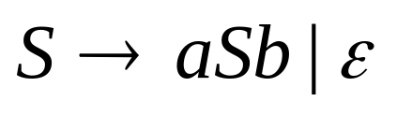
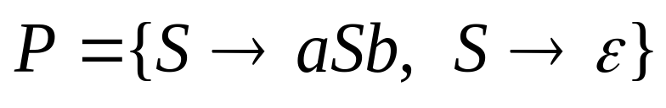



Example of Context-Free Grammar
02 Productions
start variable
variables
terminals

Slide 19
A Context-free Grammar for Palindromes
The grammar G_{pal} for the palindrome is represented by..
G_{pal} = ({P},{0,1},A,P)
where A represents the set of 05 productions:
P →є
P →0
P →1
P →0P0
P →1P1

Slide 20
Example of CFG
A CFG for simple expressions with ‘+’ & ‘*’.
It allows only the letters ‘a’ & ’b’ & the digits ‘0’ & ‘1’.
Every identifiers must begin with a & b which may be
followed by any other string in {a,b,0,1}*
G=({E,I},T,P,E)
T={0,1,a,b,+,*,(,)}
Productions:
1. E →I
2. E →E+E
3. E →E*E
4. E →(E)
5. I →a
6. I →b
7. I →Ia
8. I →Ib
9. I →I0
10 I →I1

Slide 21
Derivation using Grammar
We apply the productions of a CFG to infer the strings. There are two approaches:
  Recursive Inferences
  Derivation
  Recursive Inferences: In this approach rules use from body to head.
  Derivation: In this approach rules used from head to body.

Slide 22
Inferring string using grammar
 | String Inferred | For language of | Production Used | String (s) Used
(i) | a | I | 5 | ---
(ii) | b | I | 6 | ---
(iii) | b0 | I | 9 | (ii)
(iv) | b00 | I | 9 | (iii)
(v) | a | E | 1 | (i)
(vi) | b00 | E | 1 | (iv)
(vii) | a+b00 | E | 2 | (v), (vi)
(viii) | (a+b00) | E | 4 | (vii)
(ix) | a*(a+b00) | E | 3 | (v), (viii)
Productions:
E →I
E →E+E
E →E*E
E →(E)
I →a
6. I →b
7. I →Ia
8. I →Ib
9. I →I0
10 I →I1

Slide 23
Derivation using grammar
a*(a+b00)
E ⇒ E*E (3)
⇒ I * E (1)
⇒ a * E (5)
⇒ a * (E) (4)
⇒ a * (E + E) (2)
⇒ a * (I + E) (1)
⇒a * (a + E) (5)
⇒ a * (a + I) (1)
⇒ a * (a + I0) (9)
⇒a * (a + I00) (9)
⇒a * (a + b00) (6)
Productions:
E →I
E →E+E
E →E*E
E →(E)
I →a
6. I →b
7. I →Ia
8. I →Ib
9. I →I0
10 I →I1

Slide 24
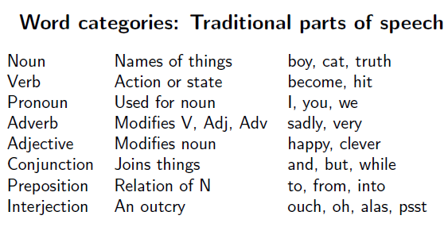
An informal example

Slide 25
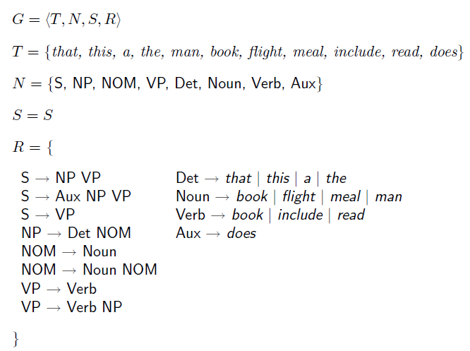
An example of CFG

Slide 26
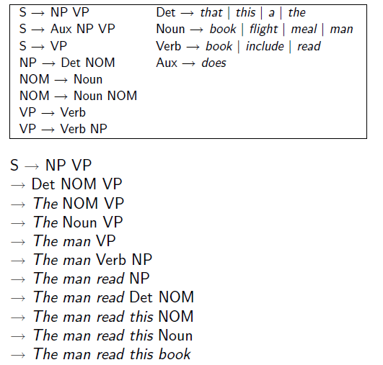
An example of CFG

Slide 27

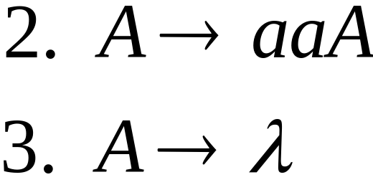
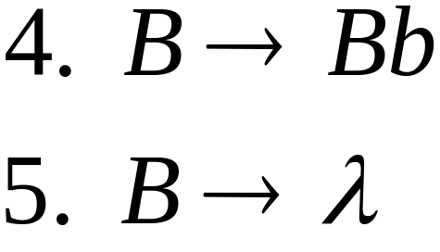
Derivation Order
Left most derivation (LMD)
Right most derivation (RMD)
Consider the following example grammar with 05 productions:

Slide 28
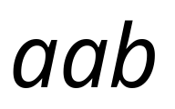

Leftmost derivation order of string :
At each step, we substitute the
leftmost variable

Slide 29

Rightmost derivation order of string :
At each step, we substitute the
rightmost variable

Slide 30
Leftmost derivation of :
Rightmost derivation of :

Slide 31
Another Example: LMD
CFG: E→I | E+E | E*E| (E)
I → a| B| Ia |Ib |I0 | I1
a*(a+b00)
E =>E*E
lm=>I*E
lm=>a*E
lm=>a*(E)
lm=>a*(E+E)
lm=>a*(I+E)
lm=>a * (a+E)
lm=>a*(a+I)
lm=>a*(a+I0)
lm=>a*(a+I00)
lm=>a*(a+b00)

Slide 32
Another Example: LMD
CFG: E→I | E+E | E*E| (E)
I → a| B| Ia |Ib |I0 | I1
a*(a+b00)
E =>E*E
rm=>E*(E)
rm=>E*(E+E)
rm=>E*(E+I)
rm=>E*(E+I0)
rm=>E*(E+I00)
rm=>E * (E+b00)
rm=>E*(I+b00)
rm=>E*(a+b00)
rm=>I*(a+I00)
rm=>a*(a+b00)

Slide 33
Derivation/Parse Tree
Representation for derivations which shows clearly has the symbols of a terminal string are grouped into substrings.
Graphical representation for a derivations

Slide 34
Properties of Parse Tree
G=(V,T,P,S).
Conditions:
Each interior node is labeled by a variable V
Each leaf is labeled by either variable, a terminal or є
If an interior node is labeled A, & its children are labeled
X₁, X_{2,}………………….,X_{k}
respectively, from the left, then A→ X₁X₂…X_{k} is a production.

Slide 35
Example
A parse tree showing the derivation of E→I+E
E→I | E+E | E*E| (E)
I → a| B| Ia |Ib |I0 | I1
E
E
+
E
I

Slide 36

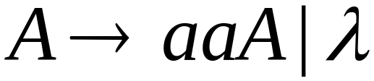
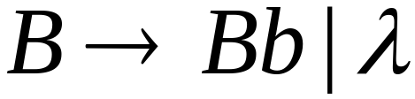
Example
Consider the same example grammar:
And a derivation of :

Slide 37




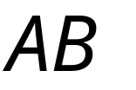
yield

Slide 38

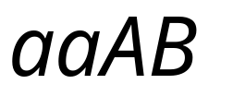

yield

Slide 39

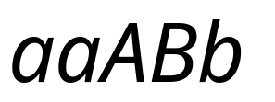
yield

Slide 40

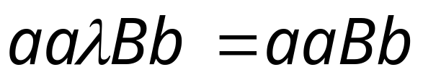
yield

Slide 41
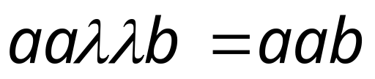
Derivation Tree
(parse tree)
yield

Slide 42
Sometimes, derivation order doesn’t matter
Leftmost derivation:
Rightmost derivation:
Give same
derivation tree

Slide 43
Example
*
A parse tree showing the derivation P ⇨ 0110.
P
P →є
P →0
P →1
P →0P0
P →1P1
0
P
0
1
P
1
є

Slide 44
Parse tree showing a*(a+b00)
E
E→I | E+E | E*E| (E)
I → a| B| Ia |Ib |I0 | I1
E
*
E
(
E
)
I
E
+
E
a
I
I
I
0
a
I
0
b

Slide 45
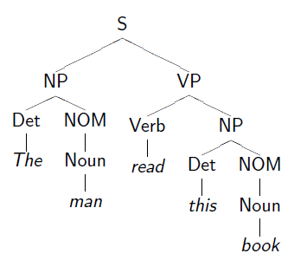
The man read this book

Slide 46
Sentential Forms
Derivations from the start symbol produce strings that have a special role. We call these “sentential forms.”
That is, if G = (V,T,P,S) be a CFG, then any string α in (V U T)*
such that S ⇨ α is a sentential form.
If S ⇨ α, then α is a left-sentential form,
and if S ⇨ α then α is a right-sentential form
*
*
lm
*
rm

Slide 47
Sentential Forms: Example
E→I | E+E | E*E| (E)
I → a| B| Ia |Ib |I0 | I1
E*(I+E) is a sentential form, since there is a derivation
E ⇒ E*E ⇒ E*(E) ⇒ E*(E+E) ⇒ E*(I+E)
This derivation is neither leftmost nor rightmost, since at the last step, the middle E is replaced.

Slide 48
Sentential Forms: Example
E ⇒ E*E ⇒ I*E ⇒ a*E Left sentential form
E ⇒ E*E ⇒ E*(E) ⇒ E*(E+E) Right
Sentential Form
lm
lm
lm
rm
rm
rm

Slide 49
Ambiguity
A grammar uniquely determines a structure for each string in its language. Not every grammar does provide unique structures.
When a grammar fails to provide unique structure, it is known as ambiguous grammar.
More than one derivation/parse tree.

Slide 50
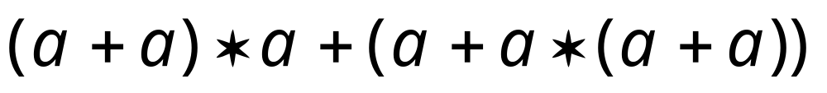
Grammar for mathematical expressions
Example strings:
Denotes any number

Slide 51





A leftmost derivation
for

Slide 52

Another
leftmost derivation
for

Slide 53
Two derivation trees for

Slide 54

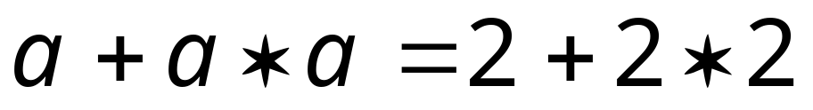

take

Slide 55





Good Tree
Bad Tree
Compute expression result
using the tree

Slide 56
Two different derivation trees
may cause problems in applications which
use the derivation trees:
Evaluating expressions
In general, in compilers
for programming languages

Slide 57


Ambiguous Grammar:
A context-free grammar is ambiguous
if there is a string which has:
two different derivation trees
or
two leftmost derivations
(Two different derivation trees give two
different leftmost derivations and vice-versa)

Slide 58
Example:
this grammar is ambiguous since
string
has two derivation trees

Slide 59
this grammar is ambiguous also because
string
has two leftmost derivations

Slide 60

Another ambiguous grammar:
IF_STMT
if EXPR then STMT
if EXPR then STMT else STMT
Variables
Terminals
Very common piece of grammar
in programming languages

Slide 61
If expr1 then if expr2 then stmt1 else stmt2
IF_STMT
if
expr1
then
STMT
if
expr2
then
stmt1
else
stmt2
Two derivation trees
IF_STMT
if
expr1
then
STMT
else
stmt2
if
expr2
then
stmt1

Slide 62
In general, ambiguity is bad
and we want to remove it
Sometimes it is possible to find
a non-ambiguous grammar for a language
But, in general ιt is difficult to achieve this

Slide 63
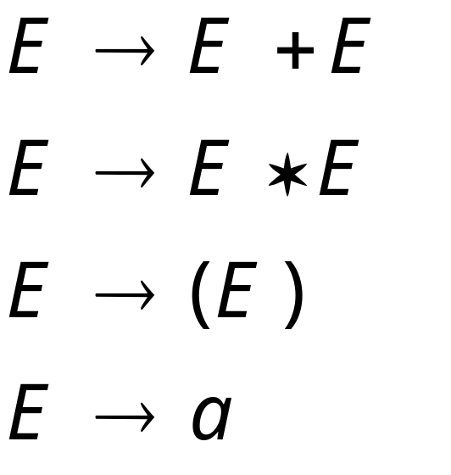
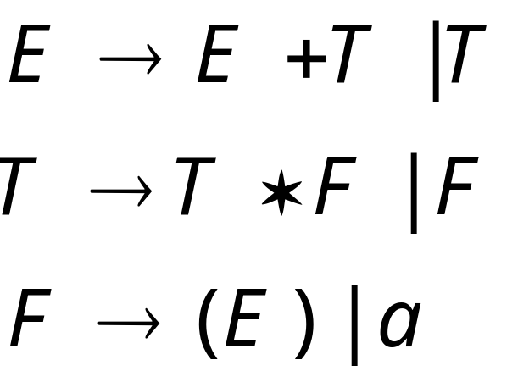
A successful example:
Equivalent
Ambiguous
Grammar
Non-Ambiguous
Grammar
generates the same
language

Slide 64

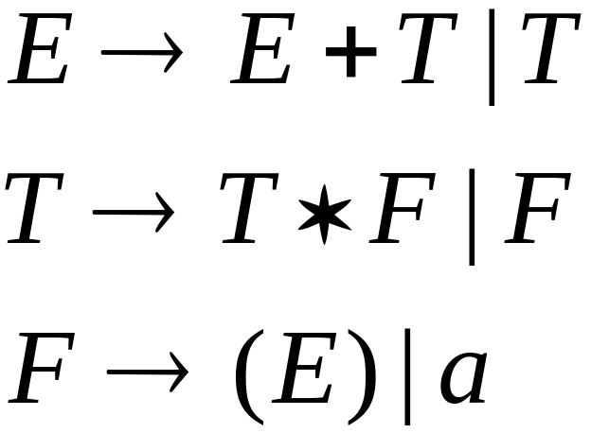


Unique
derivation tree for

Slide 65
Ambiguous Grammar example
Let us consider a CFG:
CFG: E→I | E+E | E*E| (E)
I → a| B| Ia |Ib |I0 | I1
Expression: a + a*a
LMD: E ⇨E+E⇨ I+E⇨ a+ E⇨ a+ E*E⇨ a+ I*E⇨ a+ a*E⇨ a+ a*I⇨ a+ a*a
RMD: E ⇨E*E⇨ E*I⇨ E*a⇨ E+E*a⇨ E+I*a⇨ E+ a*a⇨ I+ a*a⇨ a+ a*a
lm
lm
lm
lm
lm
lm
lm
lm
rm
rm
rm
rm
rm
rm
rm
rm

Slide 66
LMD
E
E
+
E
E
E
*
I
I
I
a
a
a
Fig: Trees yield a+a*a

Slide 67
RMD
E
E
*
E
E
E
+
I
I
I
a
a
a
Fig: Trees yield a+a*a

Slide 68
Removing Ambiguity from Grammar
Two causes of ambiguity in the grammar :
The precedence of operator is not respected.
A sequence of identical operators can group either from the left or from the right.

Slide 69
Removing Ambiguity from Grammar
The solution of the problem of enforcing precedence is to introduce several different variables.
A factor- is an expression that cannot be broken apart by any adjacent operators. The only factors in our expression language are:
i. Identifiers: It is not possible to separate the letters of identifier by attaching an operator.
ii. Any parenthesized expression, no matter what appears inside the parenthesis.
A term- is an expression that cannot be broken by the ‘+’ operator. Term is product of one or more factors.
An expression-is a sum of one or more terms.

Slide 70
Removing Ambiguity from Grammar
Let us consider a CFG:
CFG: E→I | E+E | E*E| (E)
I → a| B| Ia |Ib |I0 | I1
An unambiguous expression grammar :
I → a| B| Ia |Ib |I0 | I1
F→ I| (E)
T→ F| T*F
E→ T| E+T

